Slide 1
A browser extension for deepfake detection
Daniel Mohanadhas

Slide 2

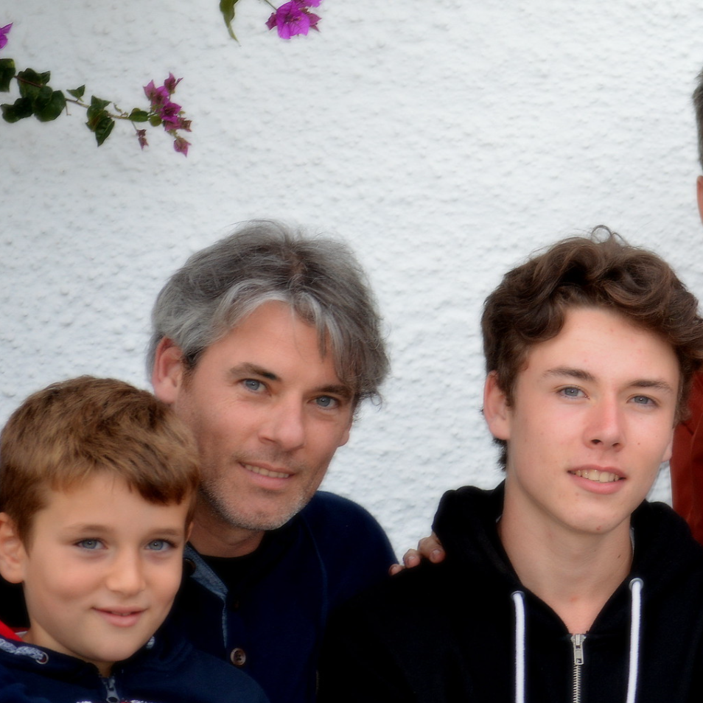

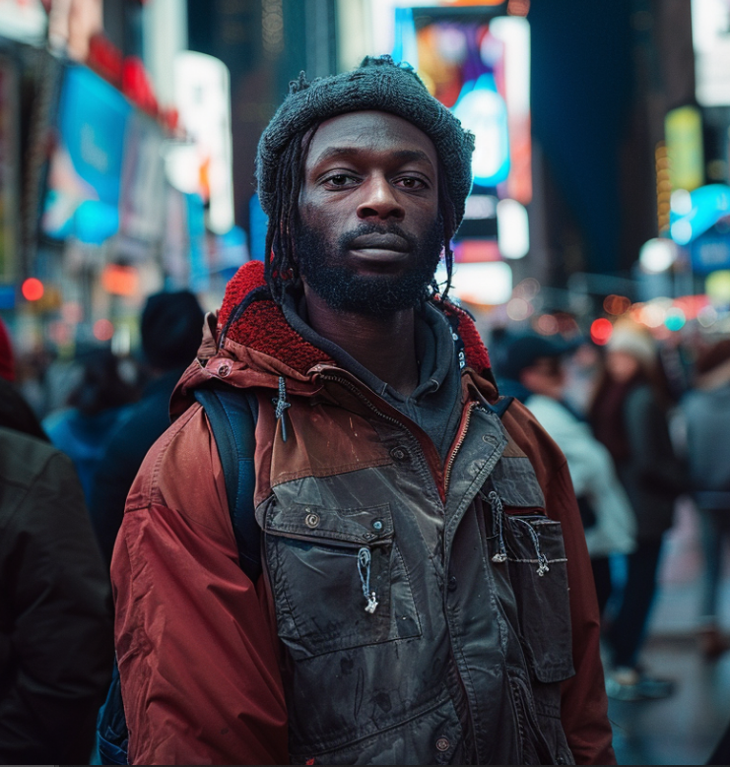
How long would it take you to determine if these images were generated by AI or Not?

Slide 3
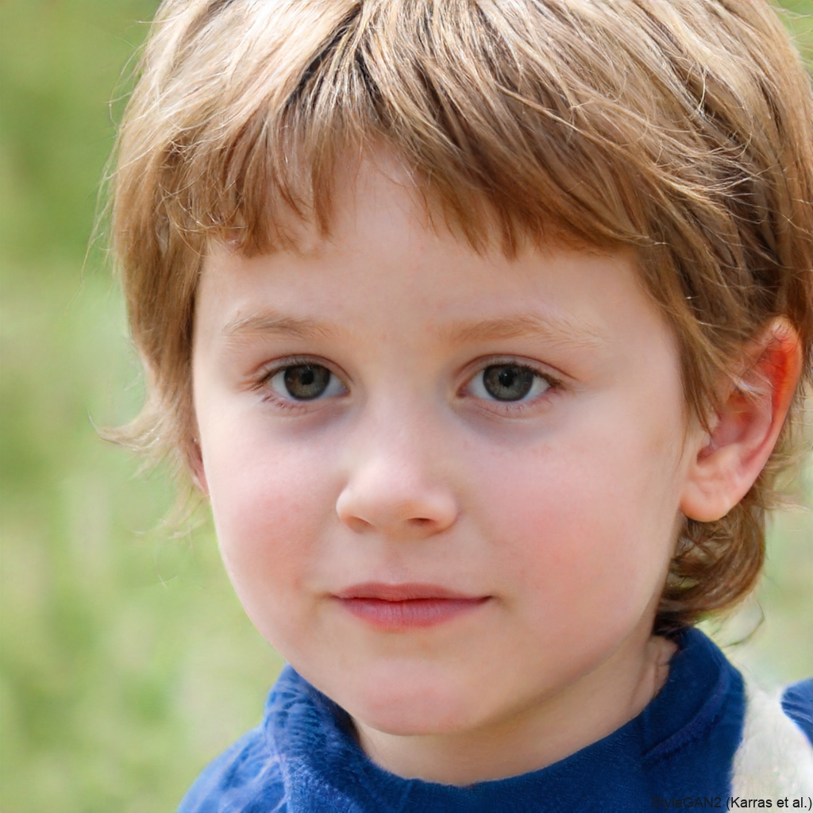
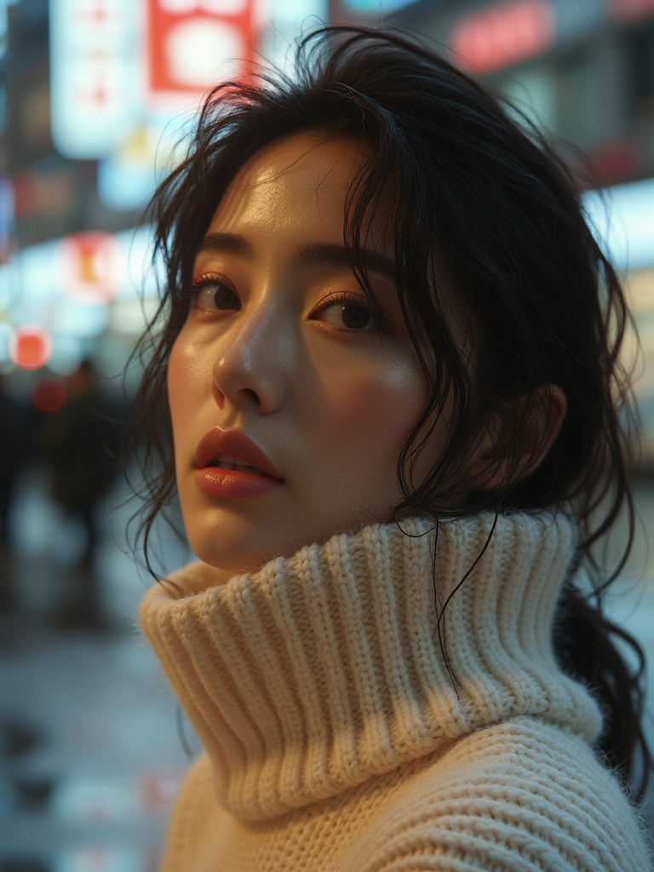
The problem
An image created with Stylegan2(left) and Midjourney(right)

Slide 4
Approach
Datasets
ELSA-D3
2.6tb, cvpr 2024 workshop
real image, fake images created with 3 diffusion models
DFFD, deepfake-in-the-wild, Celeb-DF-v2, and ffhq
Focused on human faces
Use elsa-d3 as imagenet of deepfake detection
Finetune with other datasets
Model: Efficientnetv2

Slide 5
Demo + Results
Fairly straightforward to do well on a single dataset
What about typical daily use

Slide 6
Limitations
Model is not accurate enough
Naive single model
Many popular datasets are only focused on faces, or are generated with 1 model
Relies on being able to click on the actual image itself
Doesn’t work on sites which take steps to “drm” images, like Instagram
Future work
Sync with an s3 instance
Allow screen-selection, access to local files
Fix finetuning, prediction threshold

Slide 7
Conclusion
Much harder problem than anticipated
Changing architectures/models/lora = changing artifacts
Datasets mainly focused on human faces
Need both model and content variety
Scope is likely too large
Photo editing, other categories with questionable relationship to generated/real
Created a tool where I am not restricted in usage or paywalled to quickly predict if an image was generated or real*
*unreliable results

